Slide 1
CIS 530: Logistic Regression Wrap-up
Speech and Language Processing (3rd Edition draft)
Chapter 5 “Logistic Regression”

Slide 2
Reminders
HW 2 is due tonight before 11:59pm.
Leaderboards are live until then!
Read Textbook Chapters 3 and 5
Notes:
Show leaderboard. Naive Bois is Sri Ganni Simmi Mourya. 2nd is Worthan Kwan. 3rd is Megha Mishra and Sadhana Ravoori. 4th is John Y Zhang.

Slide 3
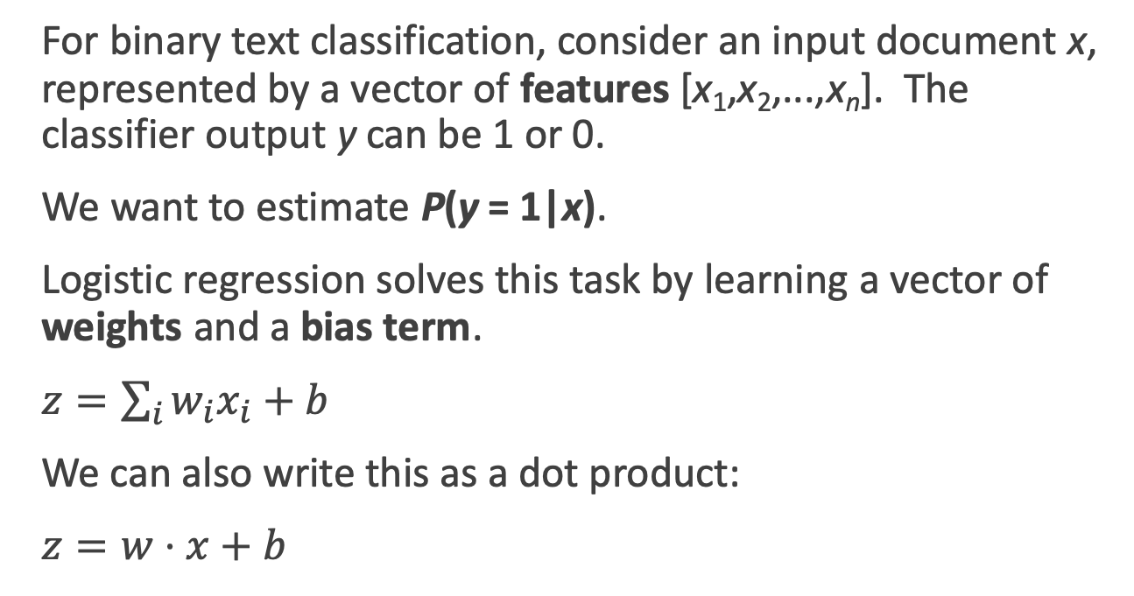
Review: Logistic Regression Classifier
For binary text classification, consider an input document x, represented by a vector of features [x₁,x₂,...,x_{n}]. The classifier output y can be 1 or 0.
We want to estimate P(y = 1|x).
Logistic regression solves this task by learning a vector of weights and a bias term.
$z=\sum_{i}{w_{i}x_{i}+b}$
We can also write this as a dot product:
$z=w⋅x+b$
Notes:
The weight wi represents how important that input feature is to the classification decision, and can be positive (meaning the feature is associated with the class) or negative (meaning the feature is not associated with the class). Thus we might expect in a sentiment task the word awesome to have a high positive weight, and abysmal to have a very negative weight. The bias term, also called the intercept, is another real number that’s added to the weighted inputs.
But note that nothing forces z to be a legal probability, that is, to lie between 0 and 1. In fact, since weights are real-valued, the output might even be negative; z ranges from −∞ to ∞.

Slide 4
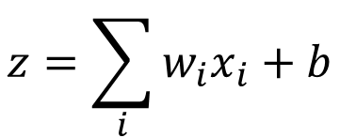
Review: Dot product
Var | Definition | Value | Weight | Product
x₁ | Count of positive lexicon words | 3 | 2.5 | 7.5
x₂ | Count of negative lexicon words | 2 | -5.0 | -10
x₃ | Does no appear? (binary feature) | 1 | -1.2 | -1.2
x₄ | Num 1st and 2nd person pronouns | 3 | 0.5 | 1.5
x₅ | Does ! appear? (binary feature) | 0 | 2.0 | 0
x₆ | Log of the word count for the doc | 4.15 | 0.7 | 2.905
b | bias | 1 | 0.1 | .1
$$z=\sum_{i}{w_{i}x_{i}+b}$$
z=0.805

Slide 5
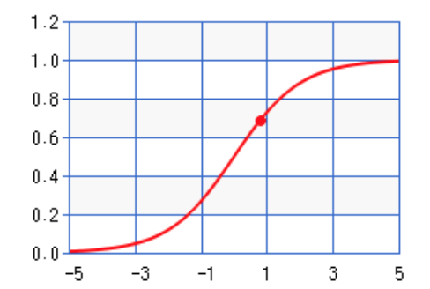
Review: Sigmoid
Var | Definition | Value | Weight | Product
x₁ | Count of positive lexicon words | 3 | 2.5 | 7.5
x₂ | Count of negative lexicon words | 2 | -5.0 | -10
x₃ | Does no appear? (binary feature) | 1 | -1.2 | -1.2
x₄ | Num 1st and 2nd person pronouns | 3 | 0.5 | 1.5
x₅ | Does ! appear? (binary feature) | 0 | 2.0 | 0
x₆ | Log of the word count for the doc | 4.15 | 0.7 | 2.905
b | bias | 1 | 0.1 | .1
σ(0.805)
= 0.69
Notes:
So the probability that this is a positive review = 69%. The probability that it’s a negative review is 31%

Slide 6
Review: Learning
How do we get the weights of the model? We learn the parameters (weights + bias) via learning. This requires 2 components:
An objective function or loss function that tells us distance between the system output and the gold output. We use cross-entropy loss.
An algorithm for optimizing the objective function. We will use stochastic gradient descent to minimize the loss function. (We’ll cover SGD later when we get to neural networks).

Slide 7
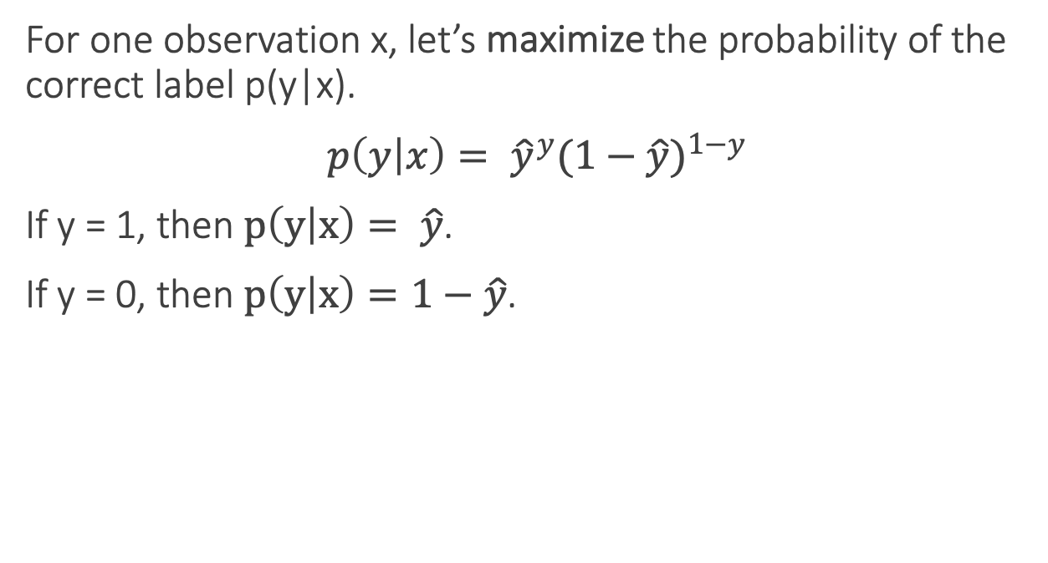
Review: Loss functions
For one observation x, let’s maximize the probability of the correct label p(y|x).
$p\left(y | x\right)= {\hat{y}}^{y}{(1−\hat{y})}^{1−y}$
If y = 1, then $p\left(y | x\right)= \hat{y}$.
If y = 0, then $p\left(y | x\right)=1−\hat{y}$.

Slide 8
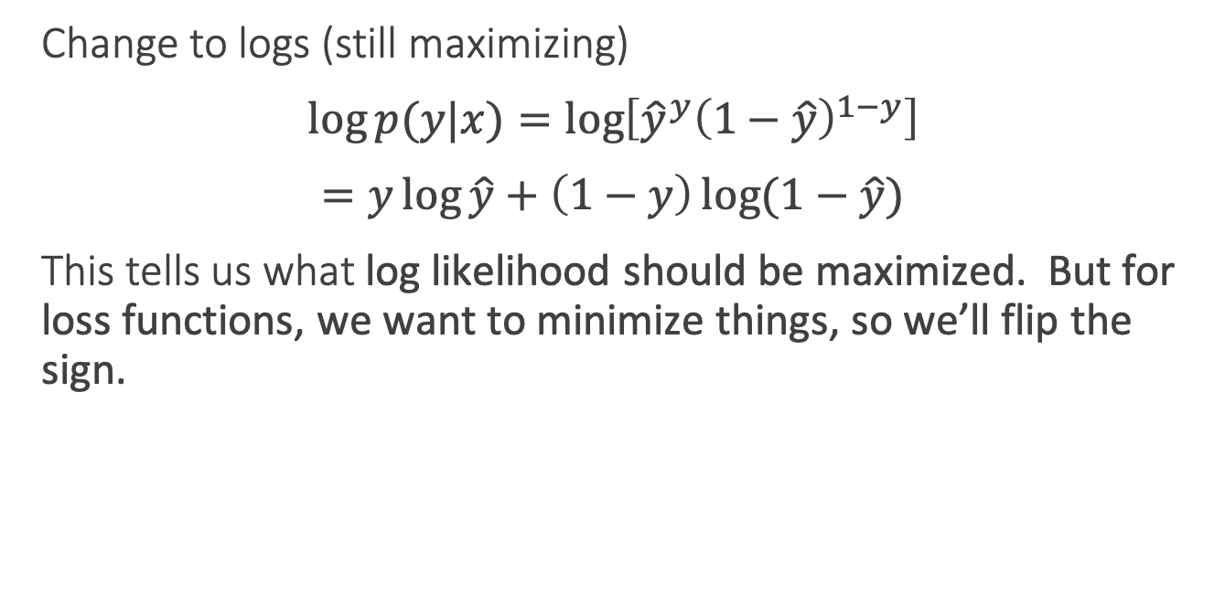
Review: Loss function
Change to logs (still maximizing)
$\log{p(y|x)}=\log\left[{\hat{y}}^{y}{\left(1−\hat{y}\right)}^{1−y}\right]$
$=y\log{\hat{y}}+\left(1−y\right)\log{(1−\hat{y})}$
This tells us what log likelihood should be maximized. But for loss functions, we want to minimize things, so we’ll flip the sign.

Slide 9
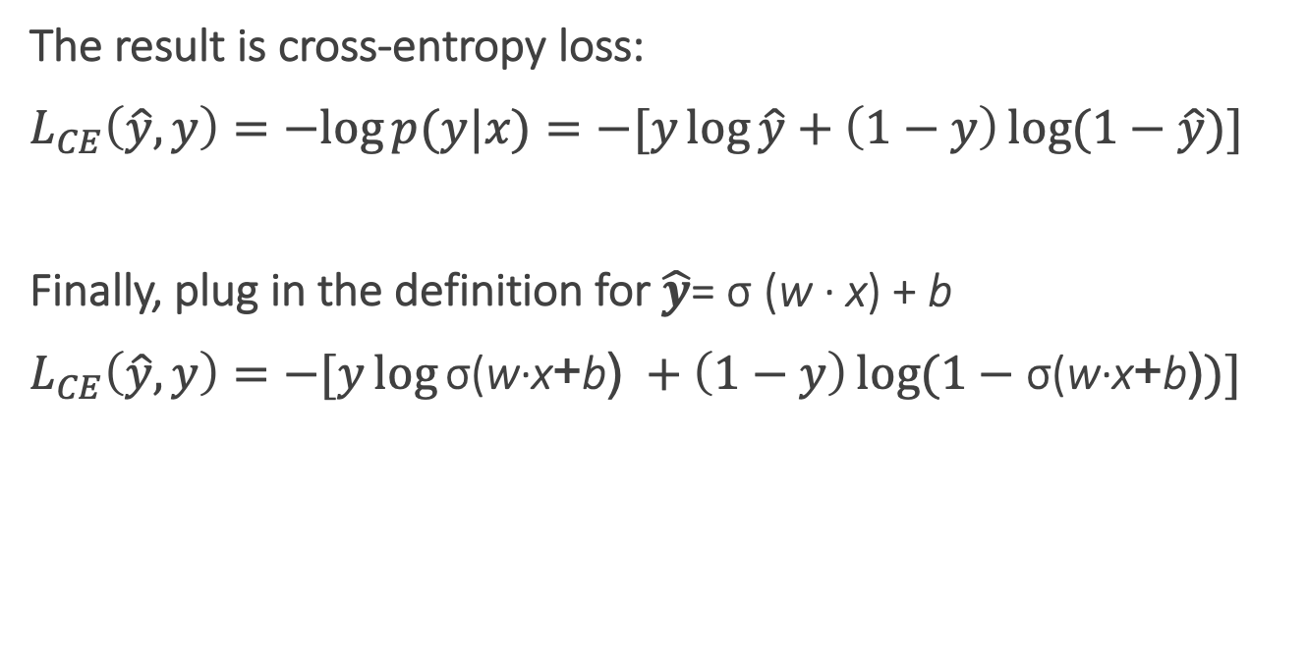
Review: Cross-entropy loss
The result is cross-entropy loss:
$L_{CE}\left(\hat{y}, y\right)=−log{p(y|x)}=−[y\log{\hat{y}}+\left(1−y\right)\log{(1−\hat{y})]}$
Finally, plug in the definition for $\hat{y}$= σ (w · x) + b
$L_{CE}\left(\hat{y}, y\right)=−[y\log{\text{σ}\text{(}\text{w}\text{·}\text{x}\text{+}\text{b}\text{)} }+\left(1−y\right)\log{(1−\text{σ}\text{(}\text{w}\text{·}\text{x}\text{+}\text{b}\text{)})]}$
Notes:
In information theory, the cross entropy between two probability distributions p and q over the same underlying set of events measures the average number of bits needed to identify an event drawn from the set, if a coding scheme is used that is optimized for an "artificial" probability distribution q, rather than the "true" distribution p.
Information theoryEntropy
Differential entropy
Conditional entropy
Joint entropy
Mutual information
Conditional mutual information
Relative entropy
Entropy rate
Asymptotic equipartition property
Rate–distortion theory
Shannon's source coding theorem
Channel capacity
Noisy-channel coding theorem
Shannon–Hartley theorem
v

Slide 10
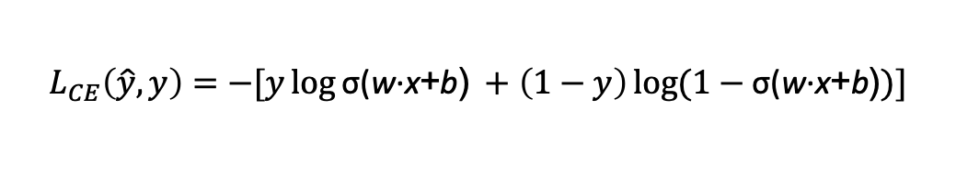
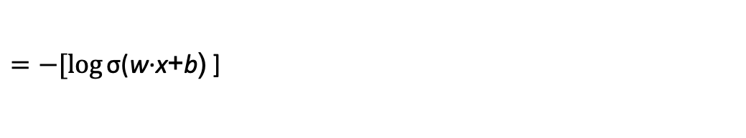
Review: Cross-entropy loss
Why does minimizing this negative log probability do what we want? We want the loss to be smaller if the model’s estimate is close to correct, and we want the loss to be bigger if it is confused.
It's hokey. There are virtually no surprises , and the writing is second-rate . So why was it so enjoyable? For one thing , the cast is great . Another nice touch is the music . I was overcome with the urge to get off the couch and start dancing . It sucked me in , and it'll do the same to you .
P(sentiment=1|It’s hokey...) = 0.69. Let’s say y=1.
$$L_{CE}\left(\hat{y}, y\right)=−[y\log{\text{σ}\text{(}\text{w}\text{·}\text{x}\text{+}\text{b}\text{)} }+\left(1−y\right)\log{(1−\text{σ}\text{(}\text{w}\text{·}\text{x}\text{+}\text{b}\text{)})]}$$
$=−[\log{\text{σ}\text{(}\text{w}\text{·}\text{x}\text{+}\text{b}\text{)} }$]
$$=−\log{\text{(}\text{0.69}\text{)}=0.37}$$
Notes:
This loss function also ensures that as probability of the correct answer is maximized, the probability of the incorrect answer is minimized; since the two sum to one, any increase in the probability of the correct answer is coming at the expense of the incorrect answer.

Slide 11
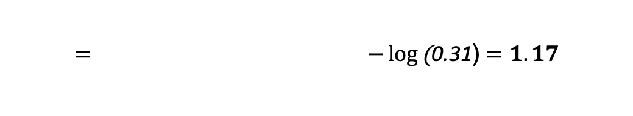
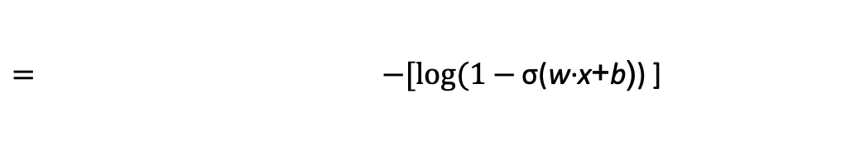
Review: Cross-entropy loss
Why does minimizing this negative log probability do what we want? We want the loss to be smaller if the model’s estimate is close to correct, and we want the loss to be bigger if it is confused.
It's hokey. There are virtually no surprises , and the writing is second-rate . So why was it so enjoyable? For one thing , the cast is great . Another nice touch is the music . I was overcome with the urge to get off the couch and start dancing . It sucked me in , and it'll do the same to you .
P(sentiment=1|It’s hokey...) = 0.69. Let’s pretend y=0.
$$L_{CE}\left(\hat{y}, y\right)=−[y\log{\text{σ}\text{(}\text{w}\text{·}\text{x}\text{+}\text{b}\text{)} }+\left(1−y\right)\log{(1−\text{σ}\text{(}\text{w}\text{·}\text{x}\text{+}\text{b}\text{)})]}$$
$= −[log(1−{\text{σ}\text{(}\text{w}\text{·}\text{x}\text{+}\text{b}\text{)}\text{)} }$]
$$= −\log{\text{(}\text{0.31}\text{)}=1.17}$$
Notes:
This loss function also ensures that as probability of the correct answer is maximized, the probability of the incorrect answer is minimized; since the two sum to one, any increase in the probability of the correct answer is coming at the expense of the incorrect answer.

Slide 12
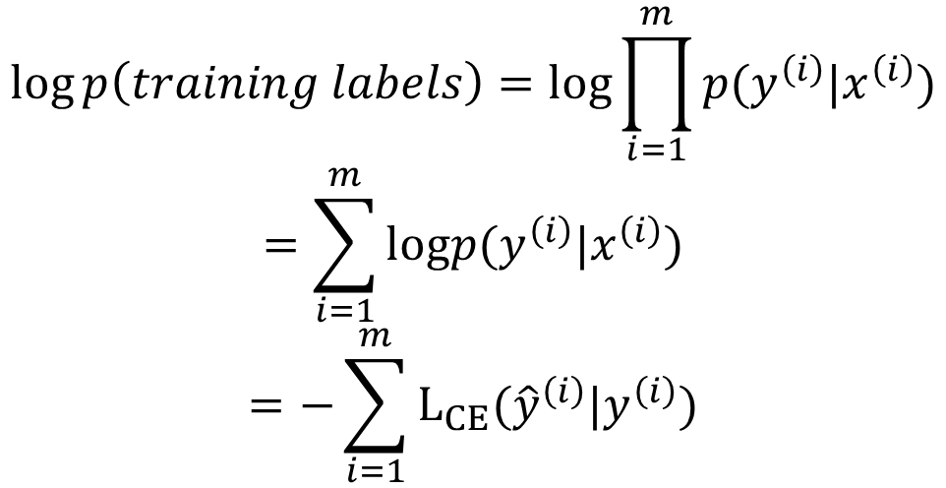
Loss on all training examples
$$\log{p\left(training labels\right)=log\prod_{i=1}^{m}{p(y^{\left(i\right)}|x^{\left(i\right)})}}$$
$$=\sum_{i=1}^{m}{logp(y^{\left(i\right)}|x^{\left(i\right)})}$$
$$=−\sum_{i=1}^{m}{L_{CE}({\hat{y}}^{\left(i\right)}|y^{\left(i\right)})}$$

Slide 13
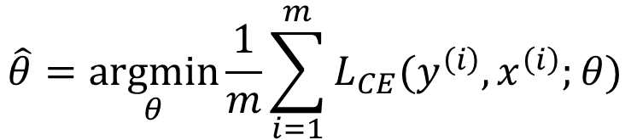
Finding good parameters
We use gradient descent to find good settings for our weights and bias by minimizing the loss function.
Gradient descent is a method that finds a minimum of a function by figuring out in which direction (in the space of the parameters θ) the function’s slope is rising the most steeply, and moving in the opposite direction.
$$\hat{θ}=\underset{θ}{argmin}{\frac{1}{m}\sum_{i=1}^{m}{L_{CE}(y^{\left(i\right)},x^{\left(i\right)};θ)}}$$
Notes:
Our goal with gradient descent is to find the optimal weights: minimize the loss function we’ve defined for the model. In Eq. 5.16 below, we’ll explicitly represent the fact that the loss function L is parameterized by the weights, which we’ll refer to in machine learning in general as θ (in the case of logistic regression θ = w, b)

Slide 14
Gradient Descent
Notes:
The intuition is that if you are skiing in a canyon and trying to descend most quickly down to the river at the bottom, you might look around yourself 360 degrees, find the direction where the ground is sloping the steepest, and godownhill in that direction.

Slide 15
CIS 530: Language Modeling with N-Grams
Speech and Language Processing (3rd Edition draft)
Chapter 3 “Language Modeling with N-Grams”

Slide 16
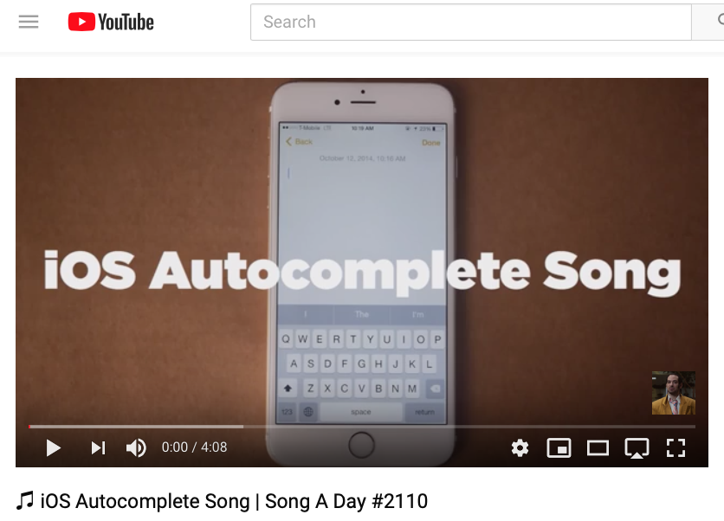
https://www.youtube.com/watch?v=M8MJFrdfGe0
Notes:
https://www.youtube.com/watch?v=M8MJFrdfGe0
Good starting part: https://youtu.be/M8MJFrdfGe0?t=103

Slide 17
Probabilistic Language Models
Autocomplete for texting
Machine Translation
Spelling Correction
Speech Recognition
Other NLG tasks: summarization, question-answering, dialog systems
Notes:
Today’s goal: assign a probability to a sentence

Slide 18
Probabilistic Language Modeling
Goal: compute the probability of a sentence or sequence of words
Related task: probability of an upcoming word
A model that computes either of these is a language model
Better: the grammar
But LM is standard in NLP

Slide 19
Probabilistic Language Modeling
Goal: compute the probability of a sentence or sequence of words
P(W) = P(w₁,w₂,w₃,w₄,w₅…w_{n})
Related task: probability of an upcoming word
P(w₅|w₁,w₂,w₃,w₄)
A model that computes either of these
P(W) or P(w_{n}|w₁,w₂…w_{n-1}) is called a language model.
Better: the grammar
But language model or LM is standard

Slide 20
How to compute P(W)
How to compute this joint probability:
P(the, underdog, Philadelphia, Eagles, won)
Intuition: let’s rely on the Chain Rule of Probability

Slide 21
The Chain Rule

Slide 22
The Chain Rule
Recall the definition of conditional probabilities
p(B|A) = P(A,B)/P(A) Rewriting: P(A,B) = P(A)P(B|A)
More variables:
P(A,B,C,D) = P(A)P(B|A)P(C|A,B)P(D|A,B,C)
The Chain Rule in General
P(x₁,x₂,x₃,…,x_{n}) = P(x₁)P(x₂|x₁)P(x₃|x₁,x₂)…P(x_{n}|x₁,…,x_{n-1})

Slide 23
The Chain Rule applied to compute joint probability of words in sentence

Slide 24
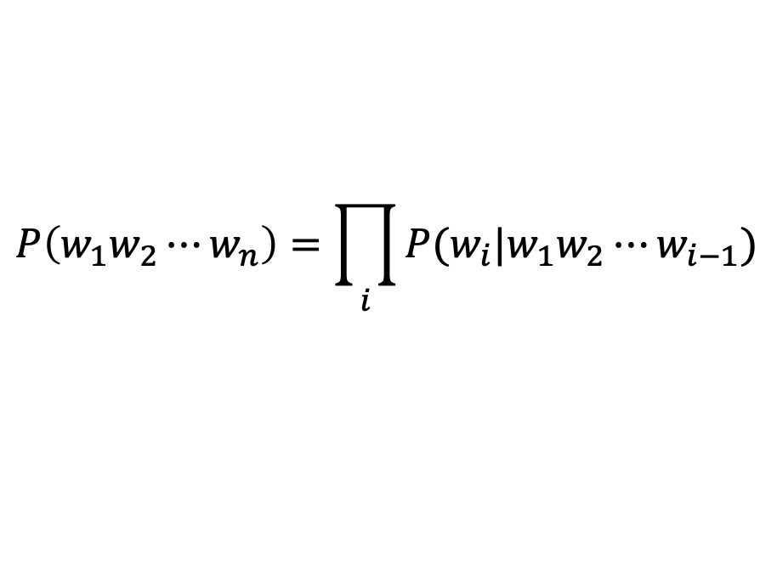
The Chain Rule applied to compute joint probability of words in sentence
P(“the underdog Philadelphia Eagles won”) =
P(the) × P(underdog|the) × P(Philadelphia|the underdog)
× P(Eagles|the underdog Philadelphia)
× P(won|the underdog Philadelphia Eagles)
$$P\left(w_{1}w_{2}⋯w_{n}\right)=\prod_{i}{P(w_{i}|w_{1}w_{2}⋯w_{i−1})}$$

Slide 25
How to estimate these probabilities
Could we just count and divide?

Slide 26
How to estimate these probabilities
Could we just count and divide? Maximum likelihood estimation (MLE)
Why doesn’t this work?
P(won|the underdog team) = Count(the underdog team won)
Count(the underdog team)
Notes:
Sentences may not appear
Need a lrage data set
Many ways of combining words into sentences
Never going to have enough data to estimate the probability of a whole sentence

Slide 27
Simplifying Assumption = Markov Assumption

Slide 28
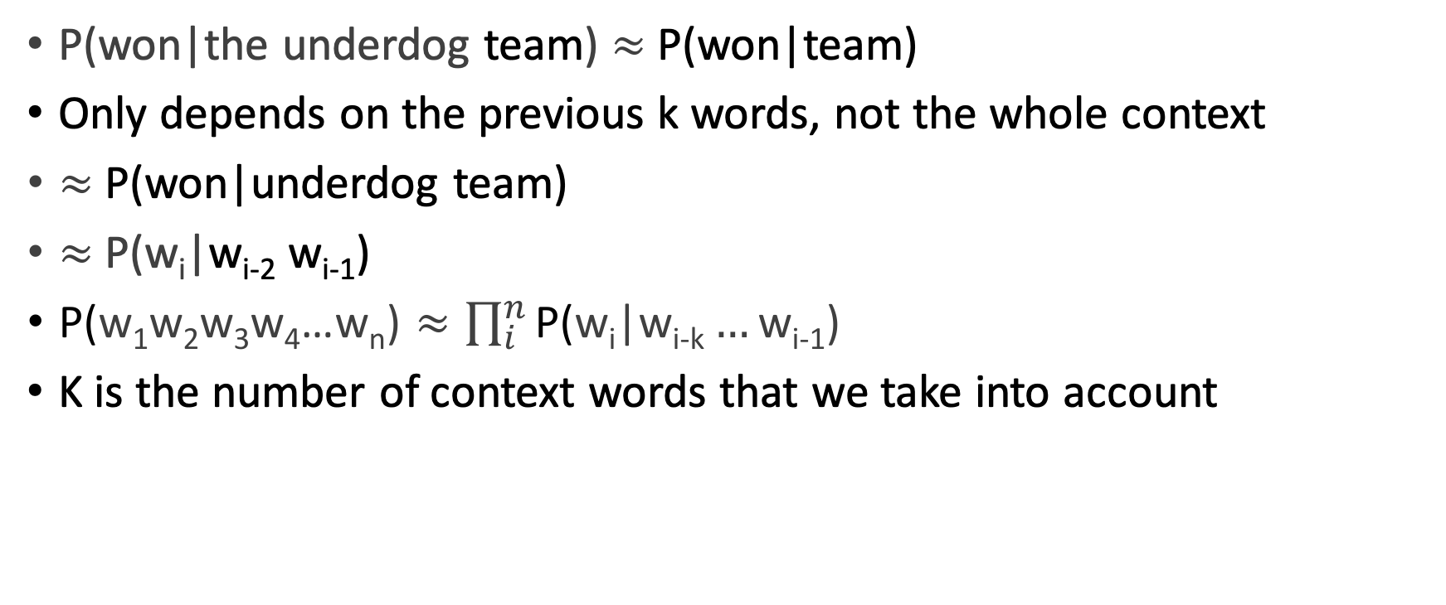
Simplifying Assumption = Markov Assumption
P(won|the underdog team) $≈$ P(won|team)
Only depends on the previous k words, not the whole context
$≈$ P(won|underdog team)
$≈$P(w_{i}|w_{i-2} w_{i-1})
$\text{P}\text{(}\text{w}\text{1}\text{w}\text{2}\text{w}\text{3}\text{w}\text{4}\text{…}\text{w}\text{n}\text{)}≈\prod_{i}^{n}{\text{P}\text{(}\text{w}\text{i}\text{|}\text{w}\text{i}\text{−}\text{k}…\text{w}\text{i}\text{−1}\text{)}}$
K is the number of context words that we take into account

Slide 29
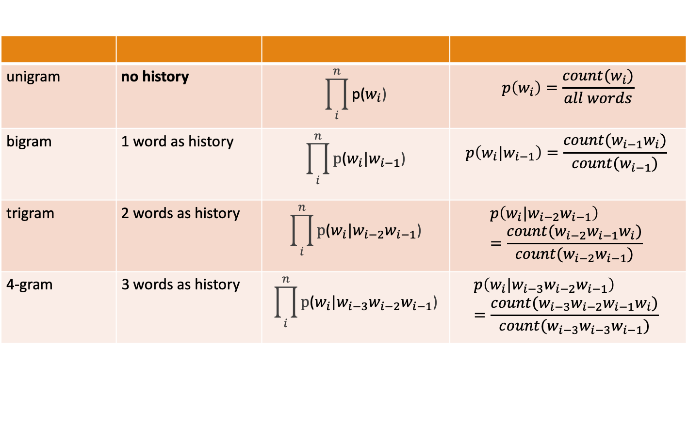
How much history should we use?
unigram | no history | $$\prod_{i}^{n}{\text{p}\text{(}w_{i}\text{)}}$$ | $$p\left(w_{i}\right)=\frac{count(w_{i})}{all words}$$
bigram | 1 word as history | $$\prod_{i}^{n}{\text{p}\text{(}w_{i}\text{|}w_{i−1}\text{)}}$$ | $$p\left(w_{i}\text{|}w_{i−1}\right)=\frac{count(w_{i−1}w_{i})}{count(w_{i−1})}$$
trigram | 2 words as history | $$\prod_{i}^{n}{\text{p}\text{(}w_{i}\text{|}w_{i−2}w_{i−1}\text{)}}$$ | $$p\left(w_{i}\text{|}w_{i−2}w_{i−1}\right)=\frac{count(w_{i−2}w_{i−1}w_{i})}{count({w_{i−2}w}_{i−1})}$$
4-gram | 3 words as history | $$\prod_{i}^{n}{\text{p}\text{(}w_{i}\text{|}{w_{i−3}w_{i−2}w}_{i−1}\text{)}}$$ | $$p\left(w_{i}\text{|}{w_{i−3}w_{i−2}w}_{i−1}\right)=\frac{count(w_{i−3}w_{i−2}w_{i−1}w_{i})}{count({w_{i−3}w_{i−3}w}_{i−1})}$$

Slide 30

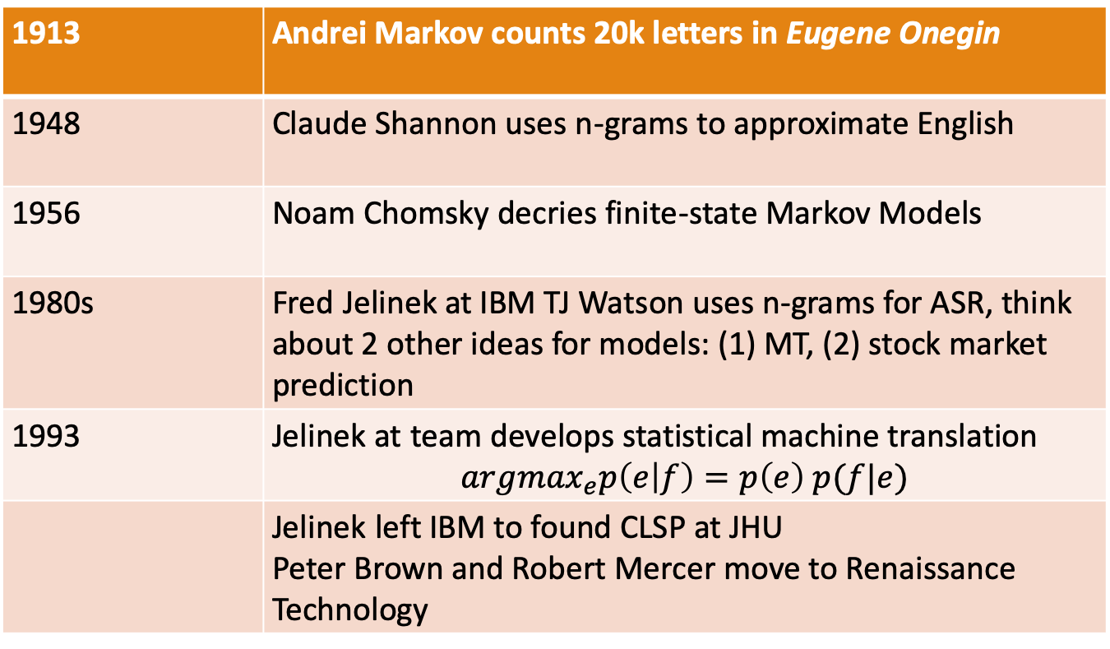
Historical Notes
1913 | Andrei Markov counts 20k letters in Eugene Onegin
1948 | Claude Shannon uses n-grams to approximate English
1956 | Noam Chomsky decries finite-state Markov Models
1980s | Fred Jelinek at IBM TJ Watson uses n-grams for ASR, think about 2 other ideas for models: (1) MT, (2) stock market prediction
1993 | Jelinek at team develops statistical machine translation $${argmax}_{e}p\left(e | f\right)=p\left(e\right) p(f|e)$$
 | Jelinek left IBM to found CLSP at JHU Peter Brown and Robert Mercer move to Renaissance Technology
Andrei Markov
Notes:
In a series of extremely influential papers starting with Chomsky (1956) and including Chomsky (1957) and Miller and Chomsky (1963), Noam Chomsky argued that “finite-state Markov processes”, while a possibly useful engineering heuristic, were incapable of being a complete cognitive model of human grammatical knowl- edge. These arguments led many linguists and computational linguists to ignore work in statistical modeling for decades.

Slide 31
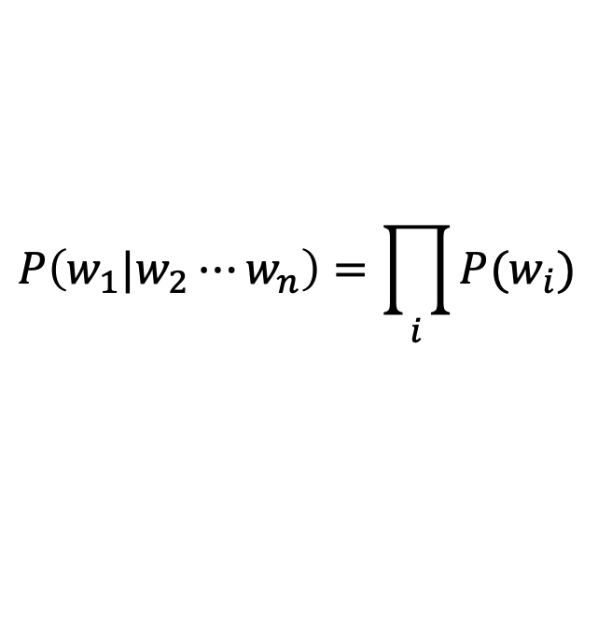
Simplest case: Unigram model
$$P\left(w_{1}|w_{2}⋯w_{n}\right)=\prod_{i}{P(w_{i})}$$
Some automatically generated sentences from a unigram model
fifth an of futures the an incorporated a a the inflation most dollars quarter in is mass
thrift did eighty said hard 'm july bullish
that or limited the

Slide 32
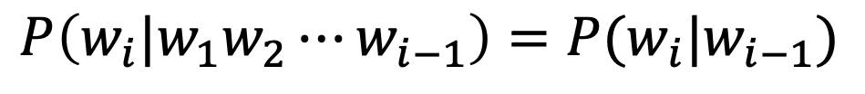
Bigram model
Condition on the previous word:
$$P\left(w_{i}|w_{1}w_{2}⋯w_{i−1}\right)=P(w_{i}|w_{i−1})$$
texaco rose one in this issue is pursuing growth in a boiler house said mr. gurria mexico 's motion control proposal
without permission from five hundred fifty five yen
outside new car parking lot of the agreement reached
this would be a record november

Slide 33
N-gram models
We can extend to trigrams, 4-grams, 5-grams
In general this is an insufficient model of language
because language has long-distance dependencies:
“The computer(s) which I had just put into the machine room on the fifth floor is (are) crashing.”
But we can often get away with N-gram models

Slide 34
Language Modeling
Estimating N-gram Probabilities

Slide 35
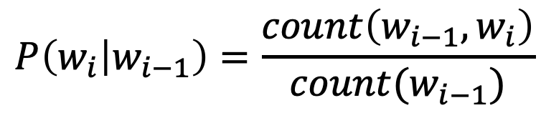
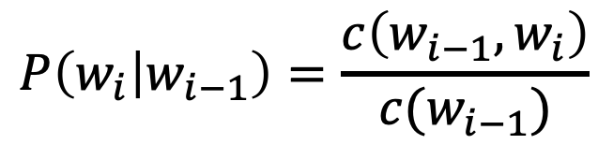
Estimating bigram probabilities
The Maximum Likelihood Estimate
$$P\left(w_{i} | w_{i−1}\right)=\frac{count\left(w_{i−1},w_{i}\right)}{count(w_{i−1})}$$
$$P\left(w_{i} | w_{i−1}\right)=\frac{c\left(w_{i−1},w_{i}\right)}{c(w_{i−1})}$$

Slide 36
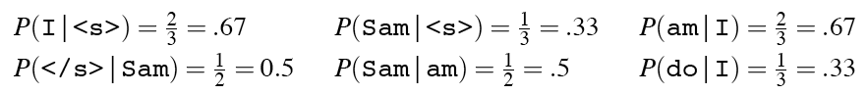
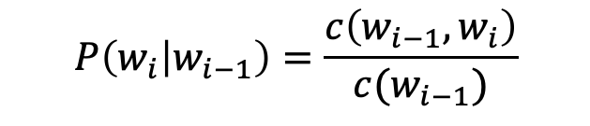
An example
<s> I am Sam </s>
<s> Sam I am </s>
<s> I do not like green eggs and ham </s>
$$P\left(w_{i} | w_{i−1}\right)=\frac{c\left(w_{i−1},w_{i}\right)}{c(w_{i−1})}$$

Slide 37
Problems for MLE
Zeros
P(memo|denied the) = 0
And we also assign 0 probability to all sentences containing it!
Train | Test
denied the allegations | denied the memo
denied the reports
denied the claims
denied the requests

Slide 38
Problems for MLE
Out of vocabulary items (OOV)
<unk> to deal with OOVs
Fixed lexicon L of size V
Normalize training data by replacing any word not in L with <unk>
Avoid zeros with smoothing

Slide 39
Practical Issues
We do everything in log space
Avoid underflow
(also adding is faster than multiplying)
$$\log\left(p_{1}⋅p_{2}⋅p_{3}⋅p_{4}\right)=\log{p_{1}+}\log{p_{2}+}\log{p_{3}+}\log{p_{4}}$$

Slide 40
Language Modeling Toolkits
SRILM
http://www.speech.sri.com/projects/srilm/
KenLM
https://kheafield.com/code/kenlm/

Slide 41
Google N-Gram Release, August 2006
…
https://ai.googleblog.com/2006/08/all-our-n-gram-are-belong-to-you.html

Slide 42
Google N-Gram Release
serve as the incoming 92
serve as the incubator 99
serve as the independent 794
serve as the index 223
serve as the indication 72
serve as the indicator 120
serve as the indicators 45
serve as the indispensable 111
serve as the indispensible 40
serve as the individual 234
https://ai.googleblog.com/2006/08/all-our-n-gram-are-belong-to-you.html

Slide 43
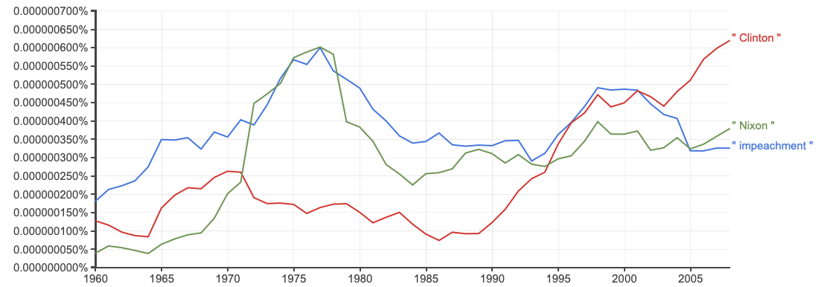
Google Book N-grams
https://books.google.com/ngrams

Slide 44
Language Modeling
Evaluation and Perplexity

Slide 45
Evaluation: How good is our model?
Does our language model prefer good sentences to bad ones?
Assign higher probability to “real” or “frequently observed” sentences
Than “ungrammatical” or “rarely observed” sentences?
We train parameters of our model on a training set.
We test the model’s performance on data we haven’t seen.
A test set is an unseen dataset that is different from our training set, totally unused.
An evaluation metric tells us how well our model does on the test set.

Slide 46
Training on the test set
We can’t allow test sentences into the training set
We will assign it an artificially high probability when we set it in the test set
“Training on the test set”
Bad science!
And violates the honor code

Slide 47
Extrinsic evaluation of language models
Notes:
Best evaluation for comparing models A and B
Put each model in a task
spelling corrector, speech recognizer, MT system
Run the task, get an accuracy for A and for B
How many misspelled words corrected properly
How many words translated correctly
Compare accuracy for A and B

Slide 48
Difficulty of extrinsic (task-based) evaluation of language models
Extrinsic evaluation
Time-consuming; can take days or weeks
So
Sometimes use intrinsic evaluation: perplexity
Bad approximation
unless the test data looks just like the training data
So generally only useful in pilot experiments
But is helpful to think about.

Slide 49
Intuition of Perplexity
The Shannon Game:
How well can we predict the next word?
I always order pizza with cheese and ____

Slide 50
Intuition of Perplexity
The Shannon Game:
How well can we predict the next word?
mushrooms 0.1
pepperoni 0.1
anchovies 0.01
….
fried rice 0.0001
….
and 1e-100
I always order pizza with cheese and ____

Slide 51
Intuition of Perplexity
The Shannon Game:
How well can we predict the next word?
Unigrams are terrible at this game. (Why?)
mushrooms 0.1
pepperoni 0.1
anchovies 0.01
….
fried rice 0.0001
….
and 1e-100
I always order pizza with cheese and ____
The 33rd President of the US was ____
I saw a ____

Slide 52
Intuition of Perplexity
The Shannon Game:
How well can we predict the next word?
mushrooms 0.1
pepperoni 0.1
anchovies 0.01
….
fried rice 0.0001
….
and 1e-100
I always order pizza with cheese and ____
The 33rd President of the US was ____
I saw a ____

Slide 53
Intuition of Perplexity
The Shannon Game:
How well can we predict the next word?
Unigrams are terrible at this game. (Why?)
A better model of a text
is one which assigns a higher probability to the word that actually occurs
mushrooms 0.1
pepperoni 0.1
anchovies 0.01
….
fried rice 0.0001
….
and 1e-100
I always order pizza with cheese and ____
The 33rd President of the US was ____
I saw a ____

Slide 54
Perplexity
The best language model is one that best predicts an unseen test set
Gives the highest P(sentence)
Perplexity is the inverse probability of the test set, normalized by the number of words
Minimizing perplexity is the same as maximizing probability
Notes:
In practice we don’t use raw probability as our metric for evaluating language models, but a variant called perplexity. The perplexity (sometimes called PP for short) of a language model on a test set is the inverse probability of the test set, normalized by the number of words. For a test set W = w1w2 ...wN,:
Note that because of the inverse in Eq. 3.15, the higher the conditional probability of the word sequence, the lower the perplexity.

Slide 55
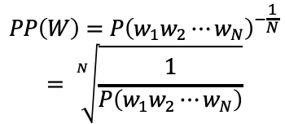
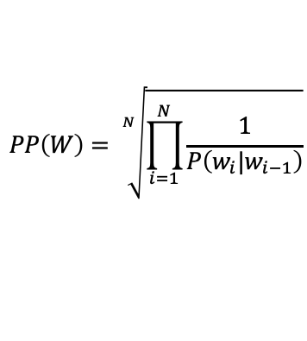
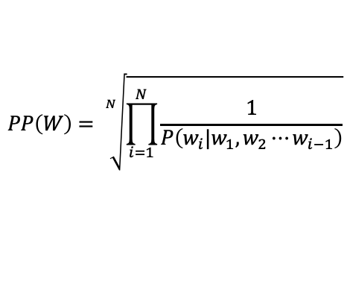
Perplexity
The best language model is one that best predicts an unseen test set
Gives the highest P(sentence)
Perplexity is the inverse probability of the test set, normalized by the number of words
Chain rule:
For bigrams:
$$PP\left(W\right)=P{\left(w_{1}w_{2}⋯w_{N}\right)}^{−\frac{1}{N}}$$
$$= \sqrt[N]{\frac{1}{P\left(w_{1}w_{2}⋯w_{N}\right)}}$$
$$PP\left(W\right)= \sqrt[N]{\prod_{i=1}^{N}{\frac{1}{P\left(w_{i}|w_{1},w_{2}⋯w_{i−1}\right)}}}$$
$$PP\left(W\right)= \sqrt[N]{\prod_{i=1}^{N}{\frac{1}{P\left(w_{i}|w_{i−1}\right)}}}$$
Minimizing perplexity is the same as maximizing probability
Notes:
In practice we don’t use raw probability as our metric for evaluating language models, but a variant called perplexity. The perplexity (sometimes called PP for short) of a language model on a test set is the inverse probability of the test set, normalized by the number of words. For a test set W = w1w2 ...wN,:
Note that because of the inverse in Eq. 3.15, the higher the conditional probability of the word sequence, the lower the perplexity.

Slide 56
Perplexity as branching factor
Let’s suppose a sentence consisting of random digits
What is the perplexity of this sentence according to a model that assign P=1/10 to each digit?

Slide 57
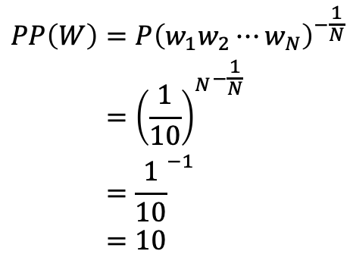
Perplexity as branching factor
Let’s suppose a sentence consisting of random digits
What is the perplexity of this sentence according to a model that assign P=1/10 to each digit?
$$\begin{aligned}PP\left(W\right)&=P{\left(w_{1}w_{2}⋯w_{N}\right)}^{−\frac{1}{N}} \\ &={{\left(\frac{1}{10}\right)}^{N}}^{−\frac{1}{N}} \\ &={\frac{1}{10}}^{−1} \\ &=10\end{aligned}$$

Slide 58
Lower perplexity = better model
Training 38 million words, test 1.5 million words, WSJ
Minimizing perplexity is the same as maximizing probability
N-gram Order | Unigram | Bigram | Trigram
Perplexity | 962 | 170 | 109

Slide 59
Language Modeling
Generalization and zeros

Slide 60
The Shannon Visualization Method
Choose a random bigram
(<s>, w) according to its probability
Now choose a random bigram (w, x) according to its probability
And so on until we choose </s>
Then string the words together
<s> I
I want
want to
to eat
eat Chinese
Chinese food
food </s>
I want to eat Chinese food

Slide 61
Approximating Shakespeare

Slide 62
Shakespeare as corpus
V=29,066 types, N=884,647 tokens
Notes:
V^2 = 844,000,000. What’s the maximum number of unique bigrams that Shakespeare produced, given 884k tokens? 884,647-1.
884,647/844,000,000 = 0.001 = He produced only 0.1% of possible bigrams.

Slide 63
Shakespeare as corpus
N=884,647 tokens, V=29,066
Shakespeare produced 300,000 bigram types out of V²= 844 million possible bigrams.
So 99.96% of the possible bigrams were never seen (have zero entries in the table)
4-grams worse: What's coming out looks like Shakespeare because it is Shakespeare

Slide 64
The wall street journal is not shakespeare (no offense)

Slide 65
Can you guess the author of these random 3-gram sentences?
They also point to ninety nine point six billion dollars from two hundred four oh six three percent of the rates of interest stores as Mexico and gram Brazil on market conditions
This shall forbid it should be branded, if renown made it empty.
“You are uniformly charming!” cried he, with a smile of associating and now and then I bowed and they perceived a chaise and four to wish for.

Slide 66
The perils of overfitting
N-grams only work well for word prediction if the test corpus looks like the training corpus
In real life, it often doesn’t
We need to train robust models that generalize!
One kind of generalization: Zeros!
Things that don’t ever occur in the training set
But occur in the test set

Slide 67
Zero probability bigrams
Bigrams with zero probability
mean that we will assign 0 probability to the test set!
And hence we cannot compute perplexity (can’t divide by 0)!

Slide 68
Language Modeling
Smoothing: Add-one (Laplace) smoothing

Slide 69
The intuition of smoothing (from Dan Klein)
When we have sparse statistics:
Steal probability mass to generalize better
P(w | denied the)
3 allegations
2 reports
1 claims
1 request
7 total
allegations
attack
man
reports
outcome
…
claims
request
P(w | denied the)
2.5 allegations
1.5 reports
0.5 claims
0.5 request
2 other
7 total
allegations
allegations
attack
man
outcome
reports
…
claims
request
Notes:
Subtract half a count from each observed event, spread the subtracted amount across other unobserved events.

Slide 70
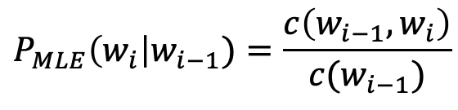
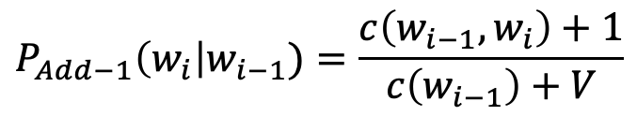
Add-one estimation
Also called Laplace smoothing
Pretend we saw each word one more time than we did
Just add one to all the counts!
MLE estimate:
Add-1 estimate:
$$P_{MLE}\left(w_{i}\right|w_{i−1})=\frac{c\left(w_{i−1},w_{i}\right)}{c(w_{i−1})}$$
$$P_{Add−1}\left(w_{i}\right|w_{i−1})=\frac{c\left(w_{i−1},w_{i}\right)+1}{c\left(w_{i−1}\right)+V}$$

Slide 71
Maximum Likelihood Estimates
The maximum likelihood estimate
of some parameter of a model M from a training set T
maximizes the likelihood of the training set T given the model M
Suppose the word “bagel” occurs 400 times in a corpus of a million words
What is the probability that a random word from some other text will be “bagel”?
MLE estimate is 400/1,000,000 = .0004
This may be a bad estimate for some other corpus
But it is the estimate that makes it most likely that “bagel” will occur 400 times in a million word corpus.

Slide 72
Add-1 estimation is a blunt instrument
So add-1 isn’t used for N-grams:
We’ll see better methods
But add-1 is used to smooth other NLP models
For text classification
In domains where the number of zeros isn’t so huge.

Slide 73
Language Modeling
Interpolation, Backoff, and Web-Scale LMs

Slide 74
Backoff and Interpolation
Sometimes it helps to use less context
Condition on less context for contexts you haven’t learned much about
Backoff:
use trigram if you have good evidence,
otherwise bigram, otherwise unigram
Interpolation:
mix unigram, bigram, trigram
Interpolation works better

Slide 75
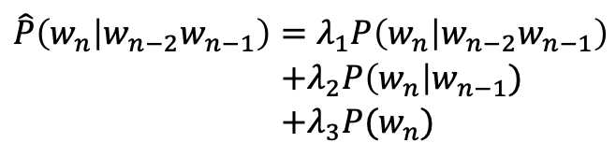
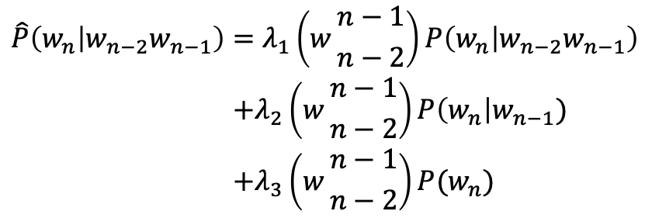
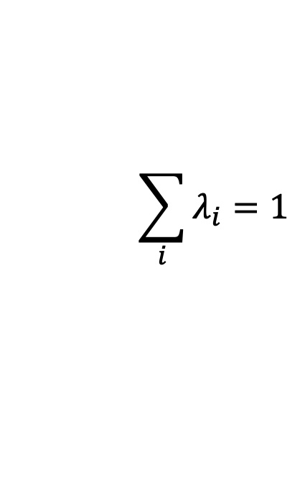
Linear Interpolation
Simple interpolation
Lambdas conditional on context:
$$\begin{aligned}\hat{P}\left(w_{n} | w_{n−2}w_{n−1}\right)&=λ_{1}P\left(w_{n} | w_{n−2}w_{n−1}\right) \\ &+λ_{2}P\left(w_{n}\right|w_{n−1}) \\ &+λ_{3}P(w_{n})\end{aligned}$$
$$\sum_{i}{λ_{i}=1}$$
$$\begin{aligned}\hat{P}\left(w_{n} | w_{n−2}w_{n−1}\right)&=λ_{1}\left(w{n−1 \atop n−2}\right)P\left(w_{n} | w_{n−2}w_{n−1}\right) \\ &+λ_{2}\left(w{n−1 \atop n−2}\right)P\left(w_{n}\right|w_{n−1}) \\ &+λ_{3}\left(w{n−1 \atop n−2}\right)P(w_{n})\end{aligned}$$

Slide 76
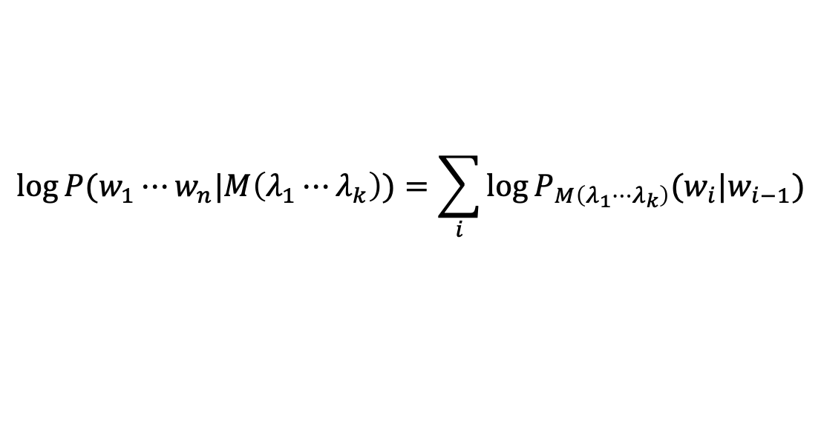
How to set the lambdas?
Use a held-out corpus
Choose λs to maximize the probability of held-out data:
Fix the N-gram probabilities (on the training data)
Then search for λs that give largest probability to held-out set:
Training Data
Held-Out Data
Test
Data
$$\log{P(w_{1}⋯w_{n}|M\left(λ_{1}⋯λ_{k}\right))}=\sum_{i}{\log{P_{M\left(λ_{1}⋯λ_{k}\right)}(w_{i}|w_{i−1})}}$$

Slide 77
Unknown words: Open versus closed vocabulary tasks
If we know all the words in advanced
Vocabulary V is fixed
Closed vocabulary task
Often we don’t know this
Out Of Vocabulary = OOV words
Open vocabulary task
Instead: create an unknown word token <UNK>
Training of <UNK> probabilities
Create a fixed lexicon L of size V
At text normalization phase, any training word not in L changed to <UNK>
Now we train its probabilities like a normal word
At decoding time
If text input: Use UNK probabilities for any word not in training

Slide 78
Huge web-scale n-grams
How to deal with, e.g., Google N-gram corpus
Pruning
Only store N-grams with count > threshold.
Remove singletons of higher-order n-grams
Entropy-based pruning
Efficiency
Efficient data structures like tries
Bloom filters: approximate language models
Store words as indexes, not strings
Use Huffman coding to fit large numbers of words into two bytes
Quantize probabilities (4-8 bits instead of 8-byte float)

Slide 79
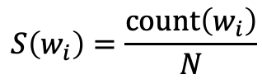
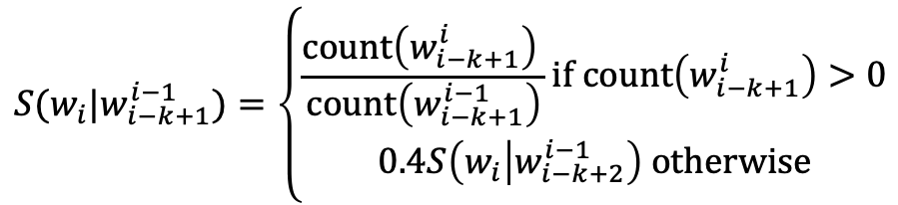
Smoothing for Web-scale N-grams
“Stupid backoff” (Brants et al. 2007)
No discounting, just use relative frequencies
$$S(w_{i}|w_{i−k+1}^{i−1})=\left\{\begin{aligned}\frac{\text{count}\left(w_{i−k+1}^{i}\right) }{\text{count}\left(w_{i−k+1}^{i−1}\right)}\text{if} \text{count}\left(w_{i−k+1}^{i}\right)>0 \\ 0.4S\left(w_{i} | w_{i−k+2}^{i−1}\right) \text{otherwise}\end{aligned}\right.$$
$$S\left(w_{i}\right)=\frac{\text{count}\left(w_{i}\right)}{N}$$

Slide 80
N-gram Smoothing Summary
Add-1 smoothing:
OK for text categorization, not for language modeling
The most commonly used method:
Extended Interpolated Kneser-Ney
For very large N-grams like the Web:
Stupid backoff

Slide 81
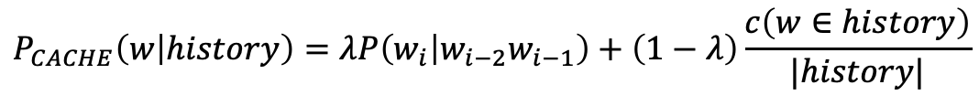
Advanced Language Modeling
Discriminative models:
choose n-gram weights to improve a task, not to fit the training set
Parsing-based models
Caching Models
Recently used words are more likely to appear
$$P_{CACHE}\left(w | history\right)=λP\left(w_{i} | w_{i−2}w_{i−1}\right)+\left(1−λ\right)\frac{c\left(w∈history\right)}{|history|}$$

Slide 82
Language Modeling
Advanced:
Kneser-Ney Smoothing

Slide 83
Absolute discounting: just subtract a little from each count
Suppose we wanted to subtract a little from a count of 4 to save probability mass for the zeros
How much to subtract ?
Church and Gale (1991)’s clever idea
Divide up 22 million words of AP Newswire
Training and held-out set
for each bigram in the training set
see the actual count in the held-out set!
It sure looks like c* = (c - .75)
Bigram count in training | Bigram count in heldout set
0 | .0000270
1 | 0.448
2 | 1.25
3 | 2.24
4 | 3.23
5 | 4.21
6 | 5.23
7 | 6.21
8 | 7.21
9 | 8.26

Slide 84
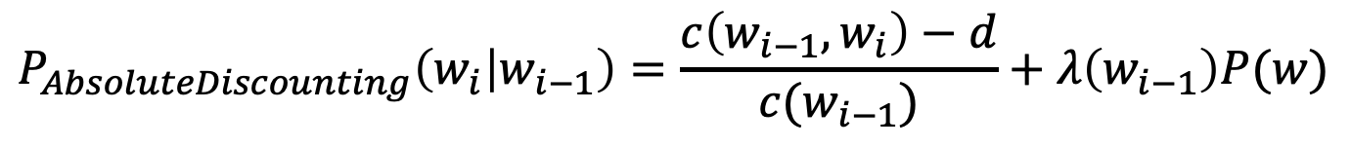
Absolute Discounting Interpolation
Save ourselves some time and just subtract 0.75 (or some d)!
(Maybe keeping a couple extra values of d for counts 1 and 2)
But should we really just use the regular unigram P(w)?
discounted bigram
Interpolation weight
$$P_{AbsoluteDiscounting}\left(w_{i} | w_{i−1}\right)=\frac{c\left(w_{i−1},w_{i}\right)−d}{c(w_{i−1})}+λ\left(w_{i−1}\right)P(w)$$
unigram

Slide 85
Kneser-Ney Smoothing I
Better estimate for probabilities of lower-order unigrams!
Shannon game: I can’t see without my reading___________?
“Francisco” is more common than “glasses”
… but “Francisco” always follows “San”
The unigram is useful exactly when we haven’t seen this bigram!
Instead of P(w): “How likely is w”
P_{continuation}(w): “How likely is w to appear as a novel continuation?
For each word, count the number of bigram types it completes
Every bigram type was a novel continuation the first time it was seen
Francisco
glasses
$P_{CONTINUATION}(w)∝|\left\{w_{i−1}:c\left(w_{i−1},w\right)>0\right\}|$

Slide 86
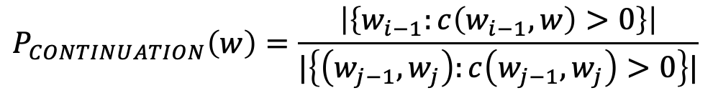
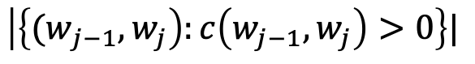
Kneser-Ney Smoothing II
How many times does w appear as a novel continuation:
Normalized by the total number of word bigram types
$P_{CONTINUATION}(w)∝|\left\{w_{i−1}:c\left(w_{i−1},w\right)>0\right\}|$
$$\left|\left\{{(w}_{j−1},w_{j}\right):c\left(w_{j−1},w_{j}\right)>0\right\}|$$
$$P_{CONTINUATION}\left(w\right)=\frac{\left|\left\{w_{i−1}:c\left(w_{i−1},w\right)>0\right\}\right|}{|\left\{\left(w_{j−1},w_{j}\right):c\left(w_{j−1},w_{j}\right)>0\right\}|}$$

Slide 87
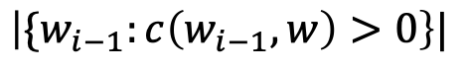
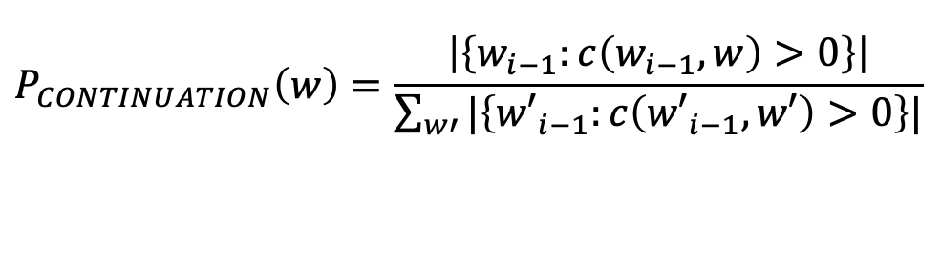
Kneser-Ney Smoothing III
Alternative metaphor: The number of # of word types seen to precede w
normalized by the # of words preceding all words:
A frequent word (Francisco) occurring in only one context (San) will have a low continuation probability
$$\left|\{w_{i−1}:c\left(w_{i−1},w\right)>0\right\}|$$
$$P_{CONTINUATION}\left(w\right)=\frac{\left|\left\{w_{i−1}:c\left(w_{i−1},w\right)>0\right\}\right|}{\sum_{w′}{|\left\{{w′}_{i−1}:c\left({w′}_{i−1},w′\right)>0\right\}|}}$$

Slide 88
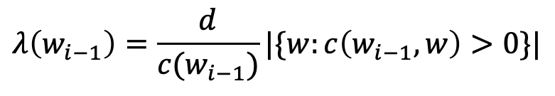
Kneser-Ney Smoothing IV
$$P_{KN}\left(w_{i} | w_{i−1}\right)=\frac{\max\left(c\left(w_{i−1},w_{i}\right)−d,0\right)}{c(w_{i−1})}+λ\left(w_{i−1}\right)P_{CONTINUATION}(w_{i})$$
λ is a normalizing constant; the probability mass we’ve discounted
$$λ\left(w_{i−1}\right)=\frac{d}{c(w_{i−1})}|\{w:c\left(w_{i−1},w\right)>0\}|$$
The number of word types that can follow w_{i-1}
= # of word types we discounted
= # of times we applied normalized discount
the normalized discount

Slide 89
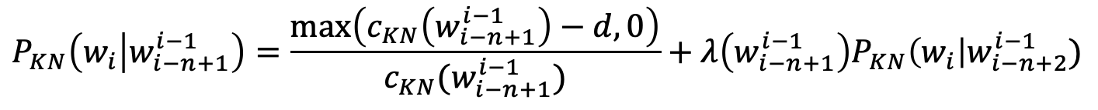
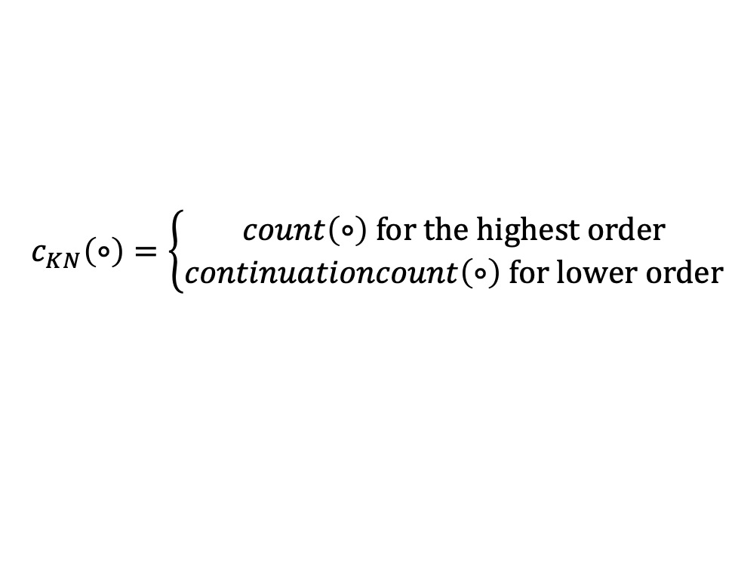
Kneser-Ney Smoothing: Recursive formulation
$$P_{KN}\left(w_{i} | w_{i−n+1}^{i−1}\right)=\frac{\max\left(c_{KN}\left(w_{i−n+1}^{i−1}\right)−d,0\right)}{c_{KN}(w_{i−n+1}^{i−1})}+λ\left(w_{i−n+1}^{i−1}\right)P_{KN}\left(w_{i}\right|w_{i−n+2}^{i−1})$$
$$c_{KN}\left(∘\right)=\left\{\begin{aligned}count\left(∘\right) \text{for} \text{the} \text{highest} \text{order} \\ continuationcount\left(∘\right) \text{for} \text{lower} \text{order}\end{aligned}\right.$$
Continuation count = Number of unique single word contexts for $∘$

Slide 90
Vector Space Semantics
Read Chapter 6 in the draft 3rd edition of Jurafsky and Martin

Slide 91
What does ongchoi mean?
Suppose you see these sentences:
Ong choi is delicious sautéed with garlic.
Ong choi is superb over rice
Ong choi leaves with salty sauces
And you've also seen these:
…spinach sautéed with garlic over rice
Chard stems and leaves are delicious
Collard greens and other salty leafy greens
Conclusion:
Ongchoi is a leafy green like spinach, chard, or collard greens

Slide 92
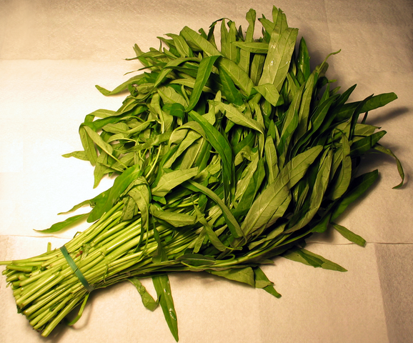
Ong choi: Ipomoea aquatica "Water Spinach"
Yamaguchi, Wikimedia Commons, public domain

Slide 93
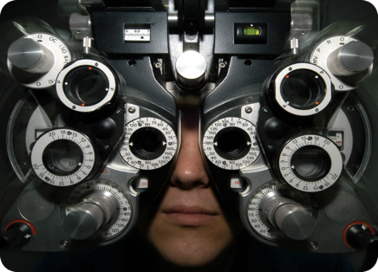
Distributional Hypothesis
If we consider optometrist and eye-doctor we find that, as our corpus of utterances grows, these two occur in almost the same environments. In contrast, there are many sentence environments in which optometrist occurs but lawyer does not...
It is a question of the relative frequency of such environments, and of what we will obtain if we ask an informant to substitute any word he wishes for oculist (not asking what words have the same meaning).
These and similar tests all measure the probability of particular environments occurring with particular elements... If A and B have almost identical environments we say that they are synonyms.
–Zellig Harris (1954)

Slide 94
We'll build a new representation of words that encodes their similarity
Each word = a vector
Similar words are "nearby in space"

Slide 95
We define a word as a vector
Called an "embedding" because it's embedded into a space
The standard way to represent meaning in NLP
Fine-grained model of meaning for similarity
NLP tasks like sentiment analysis
With words, requires same word to be in training and test
With embeddings: ok if similar words occurred!!!
Question answering, conversational agents, etc

Slide 96
We'll introduce 2 kinds of embeddings
Tf-idf
A common baseline model
Sparse vectors
Words are represented by a simple function of the counts of nearby words
Word2vec
Dense vectors
Representation is created by training a classifier to distinguish nearby and far-away words

